Slide 1
Terraform init
ow

Slide 2
Overview
The terraform init command initializes a working directory containing Terraform configuration files.
This is the first command that should be run after writing a new Terraform configuration or cloning an existing one from version control.
It is safe to run this command multiple times.

Slide 3
Terraform init
Purpose: terraform init initializes a Terraform working directory, setting up the necessary components for managing infrastructure using Terraform.
Usage: Open a terminal, navigate to your Terraform project directory, and run terraform init.
Example Scenario: Suppose you have a project where you want to provision and manage AWS EC2 instances using Terraform. After setting up your project directory and creating the necessary Terraform files, you run terraform init to initialize the working directory. This command performs the following tasks:
Downloads the required provider plugins, such as the AWS provider plugin, to interact with the AWS platform.
Sets up the local Terraform environment, including creating a .terraform directory to store downloaded plugins and other necessary files.

Slide 4
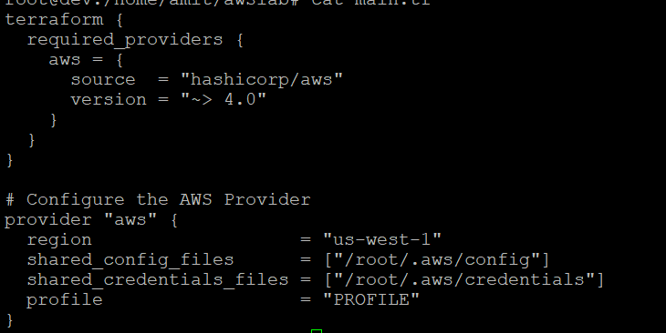
..

Slide 5
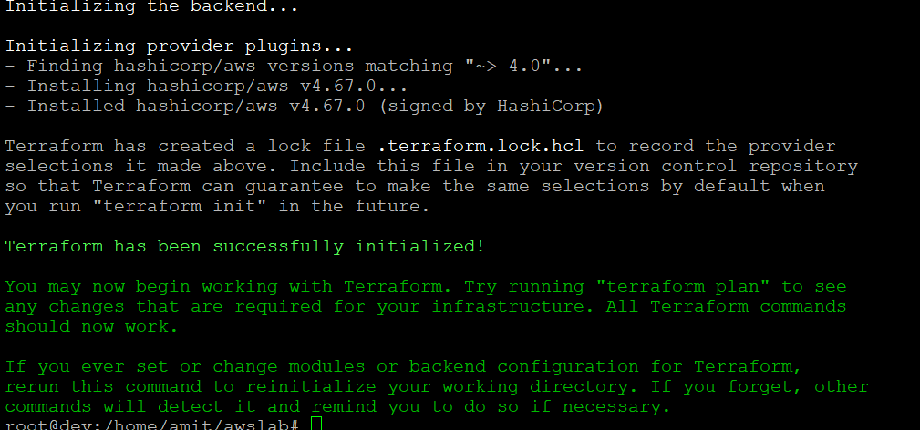
..

Slide 6
What happens when init starts
Creates a file .terraform.lock.hcl
provider "registry.terraform.io/hashicorp/local" {
version = "2.4.0"
hashes = []
This file is maintained automatically by "terraform init".
# Manual edits may be lost in future updates.

Slide 7
..
Creates .terraform folder
Maintains providers details
Backends info
Plugin info

Slide 8
Cmds
terraform init
terraform init -upgrade=false

Slide 9
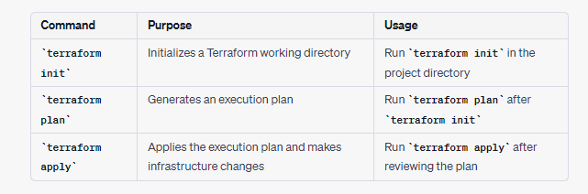
Difference

Slide 10
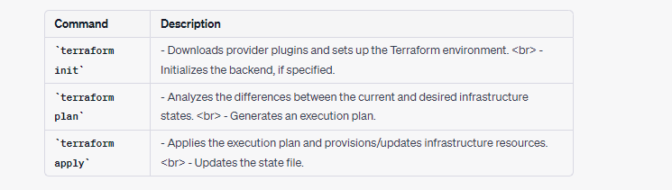
Summary

